Slide 1
Event Definition
Jiannong Cao
Internet and Mobile Computing Lab
Hong Kong Polytechnic University

Slide 2

Outline
Motivation
Related Works
Event Definition Language (EDL)
Application Examples

Slide 3
Motivation
Event-based pub/sub middleware needs a mechanism to allow the users to define composite events.
No existing work defines any event definition language for WSN

Slide 4

Related Works
Generalized Event Monitoring language (GEM):
  Designed for ECA (Event-Condition-Action) systems.
  Allows rule definition so that programmer can specify the action to be taken when an event is triggered.
  Provides operators for specifying temporal relationships such as conjunction, disjunction and sequence.

Slide 5
Related Works
High-Level Query Language for Events:
  Designed for XML and Web data
  Similar to SQL
  Uses ‘on’ clause to define composite events which can be conjunctions or disjunction
  Uses ‘where’ clause to define the event filters
  Provides some built-in functions for specifying temporal relationships

Slide 6
Related Works
Java Event CorrelaTOR (JECTOR):
  Designed for ECA system with real-time logic
  Provides event operators and event functions for describing temporal constraints.
  Gives an example of a easy and application-specific language which can be translated to JECTOR.

Slide 7
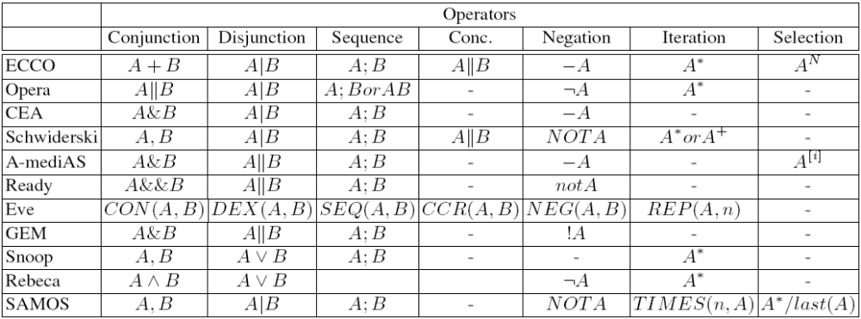
Related works
Unified Semantics for Event Correlation:
  Summarizes the event operators used in existing works on event definition language

Slide 8

Event Definition Language
Language elements:
  Event definition
    Attribute list
    ‘on’ clause for composite events
    ‘where’ clause for event filters
    Built-in functions and operators
  Subscription statement

Slide 9
Event Definition Language
Attribute list:
  An attribute has a name and type
  Syntax: <type> <attribute name> [assignment_expression]
‘where’ clause:
  Used as event filters
  Similar idea borrowed from SQL
  Contains a set of logical expressions

Slide 10
Event Definition Language
‘on’ clause:
  Used for event composition
  Similar idea borrowed from ‘High-Level Query Language for Events’ but simplified
  Contains a list of event instances combined with event operators.
  Syntax: on { <event_type> <event_id> [composite_event_operator] … }

Slide 11
Event Definition Language
‘subscribe’ statement:
  Used to subscribe the events of interest
  Syntax: subscribe <event_id>;

Slide 12
Built-in Functions and Operators
Aggregate functions:
  average(), sum() …
Composite event operators (used in ‘on’ clause):
  Conjunction: e1 && e2
  Disjunction: e1 || e2
Event operators/functions:
  Sequence: e1->e2
  Parallel: e1|e2
  Test for existence: exist(e1->e2) (returns true if e1 and e2 have sequence relationship)
Other functions:
  Location functions: ‘within’

Slide 13
Application Example 1 - Monitoring
Application Scenario:
  monitor the event such that 10 minutes after the average temperature of room A rises above 30, the average temperature of room B also rises above 30
Events required:
  Average temperature event
  Composite event of two average event

Slide 14
Monitoring – Event Definition
Event definition for Room A:
  Event AvgLightA {
  int avg_light=average(Sensor.light);
  int location=Sensor.coordinate;
  } where {
  average(Sensor.light)>50 and
  within(Sensor.coordinate, ‘Room A’)
  }

Slide 15
Monitoring – Event Definition
Event definition for Room B:
  Event AvgLightB {
  int avg_light=average(Sensor.light);
  int location=Sensor.coordinate;
  } where {
  average(Sensor.light)>50 and
  within(Sensor.coordinate, ‘Room B’)
  }

Slide 16
Monitoring – Event Definition
Composite event definition
  Event LightSeq {
  } on {
  AvgLightA e1 and
  AvgLightB e2
  } where {
  exists (e1->e2)
  }
Subscribe statement:
  subscribe LightSeq;

Slide 17
Application Example 2 - Tracking
Application scenario:
  Track an object which moves with a special pattern
Events required:
  Tracking event: use light event in this example
  Composite event: use operators to combine the tracking events.

Slide 18
Tracking – Event Definition
Tracking event (use light in this example):
  Event LightEvent {
  int light=Sensor.light;
  int location=Sensor.coordinate;
  } where {
  System.light>100 and
  }

Slide 19
Tracking – Event Definition
Composite event:
  Event Tracking {
  } on {
  LightEvent e1 and
  LightEvent e2 and
  LightEvent e3
  } where {
  exists (e1->e2->e3) and
  e2.location-e1.location==1 and
  e3.location-e2.location==2
  }
Subscribe statement:
  subscribe Tracking;

